Slide 1


www.fincart.com
011-30018181 | info@fincart.com

Slide 2

Which is higher (10)⁵ or (5)¹⁰?

Slide 3
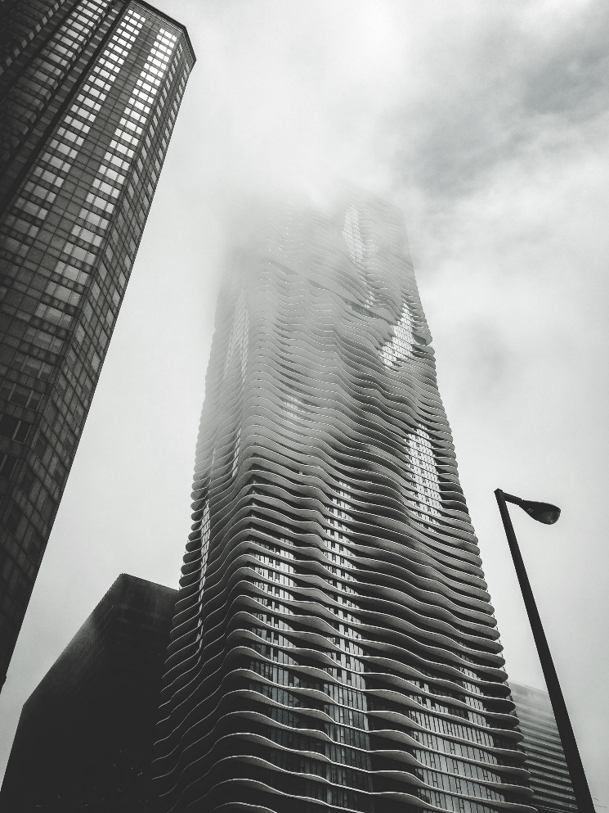
10⁵ : 1 lakh
5¹⁰ : 97.65 lakh

Slide 4
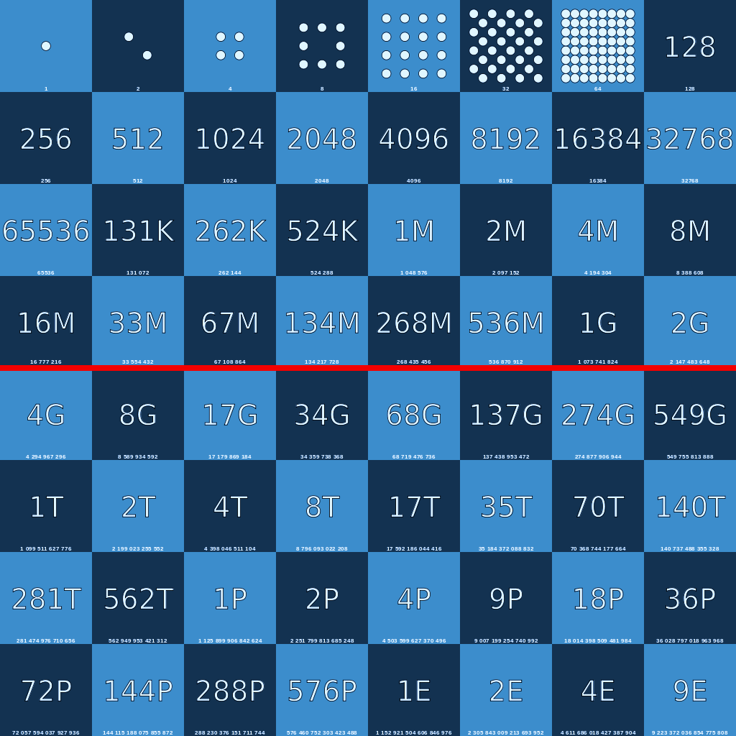
Secret Sauce To Wealth Creation
A = P (1+R)^{N}
A = Amount
P = Principal
R = Return N = Time Horizon of Investments

Slide 5
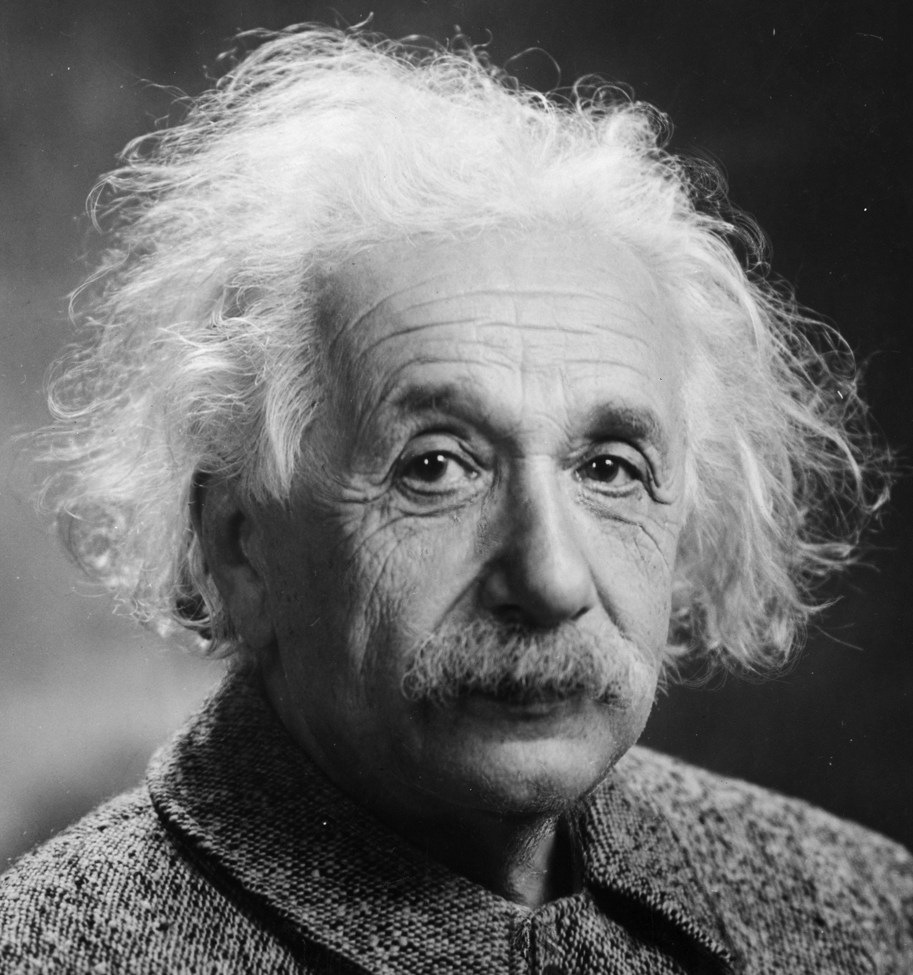
Compound interest is the 8th wonder of the world. He who understands it, Earns it... He who doesn't, Pays it!
-Albert Einstein

Slide 6
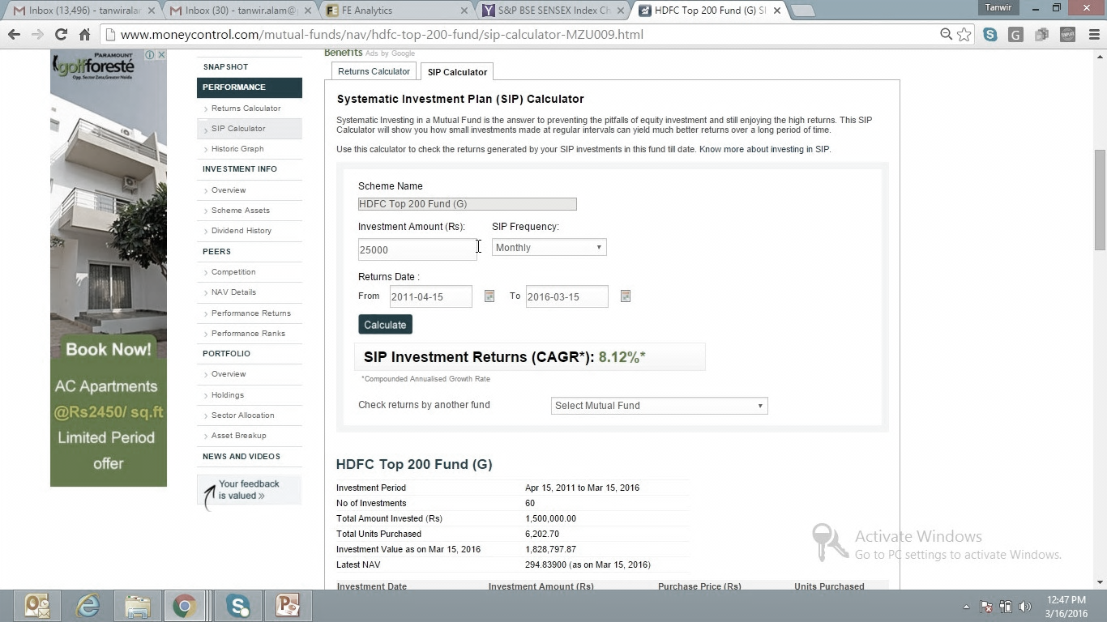
SIP of
`25,000/- per month for 5 yrs.
http://www.moneycontrol.com/mutual-funds/nav/hdfc-top-200-fund/sip-calculator-MZU009.html
Systematic Investment Plan (SIP) of ` 25000 per month; amounting to an Investment of ` 15 Lakhs per 5 Years
The Investment of ` 15 Lakhs grows to ` 18.29 Lakhs only
Compounded Annual Growth Rate
(CAGR): 8.12%
Power of Compounding DOESN’T WORK for a investment period of 5 Years & below

Slide 7
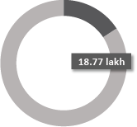
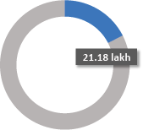
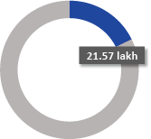
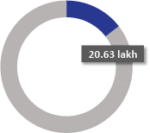
5 year return
SIP of
`25,000/- per month for 5 yrs.
How much 15 lakh grows in some other funds
Franklin India Index Fund - NSE Nifty Plan
Franklin India Bluechip Fund
SBI Magnum Equity Fund
UTI Equity

Slide 8
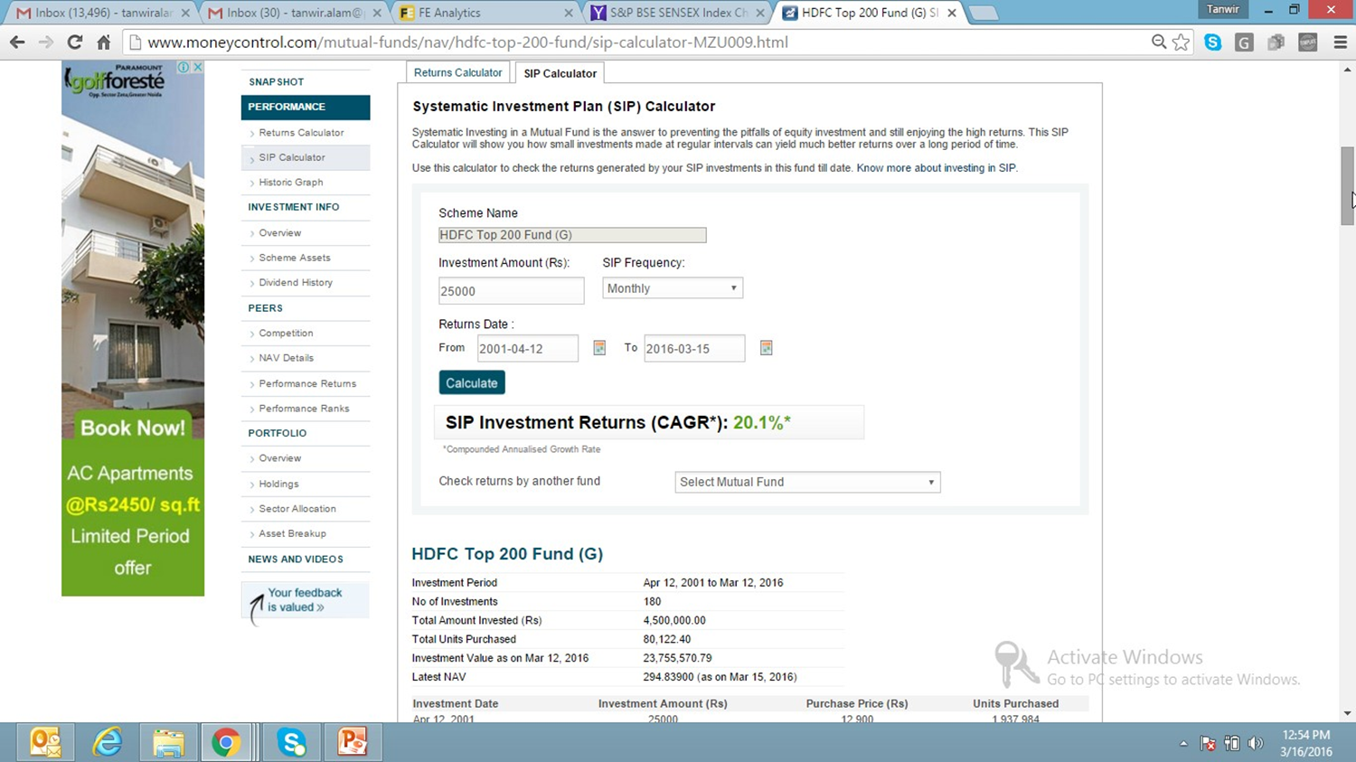
SIP of
`25,000/- per month for 15 yrs.
http://www.moneycontrol.com/mutual-funds/nav/hdfc-top-200-fund/sip-calculator-MZU009.html
Systematic Investment Plan (SIP) of Rs 25000 per month;
amounting to an Investment of Rs 45 Lakhs over 15 Years
The Investment of Rs 45 Lakhs grows to Rs 238 Lakhs
Compounded Annual Growth Rate
(CAGR) : 20.1%
Over long term horizon it WORKS LIKE MAGIC

Slide 9
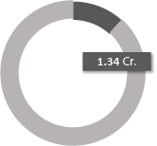
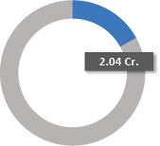

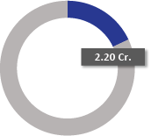
15 year return
SIP of
`25,000/- per month for 15 yrs.
How much 45 lakh grows in some other funds
Franklin India Index Fund - NSE Nifty Plan
Franklin India Bluechip Fund
SBI Magnum Equity Fund
UTI Equity

Slide 10
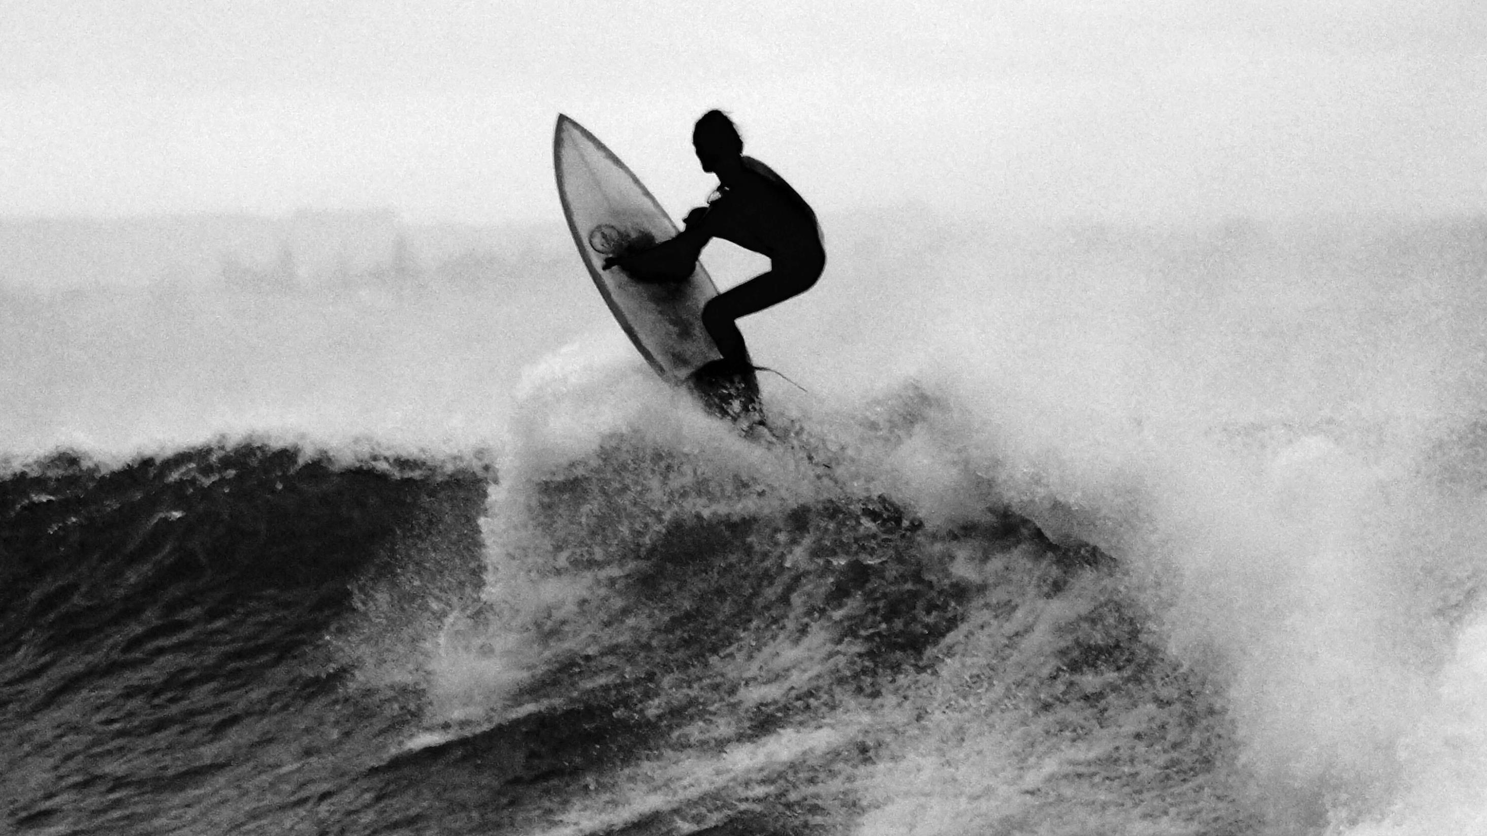
….But What About Risk?

Slide 11
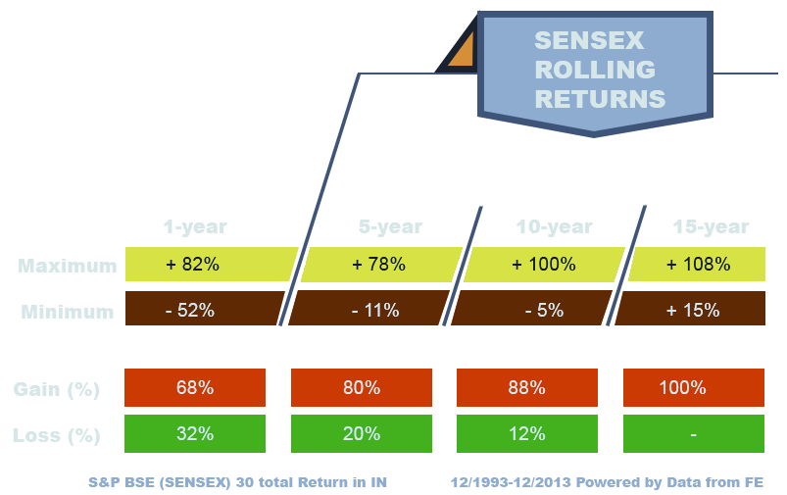
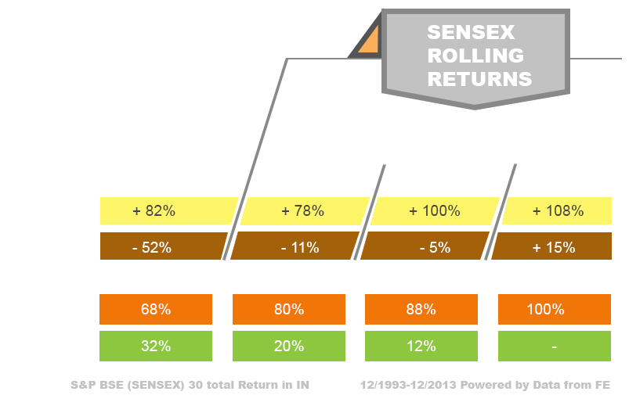
Equity Investments – Gain & Loss Probability
GAIN
The Probability of making money
from Equity Market increases with increasing time horizon of investments.
Almost certainly positive for an Investment time horizon of 10 years.
LOSS

Slide 12
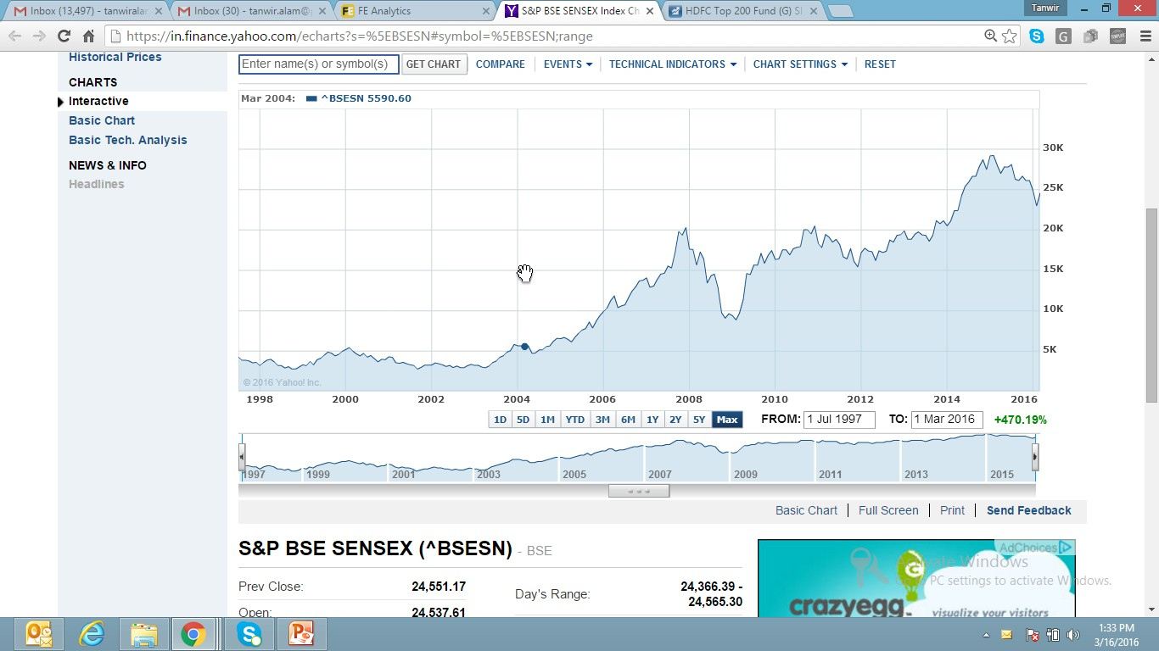
Try to evaluate any period of 10 years
https://in.finance.yahoo.com/echarts?s=%5EBSESN#symbol=%5EBSESN;range
Evaluate any period over 10 years
You will have a positive experience
24,870
20,513
17648
16,357
17,193
9919
5695
8891
3622
5205
3311

Slide 13

The markets will have its ups n downs;
but; It has
never destroyed capital
for
Investments time horizon of over
10 years

Slide 14

Don’t wait any more Start your Wealth Accumulation Journey NOW?

Slide 15
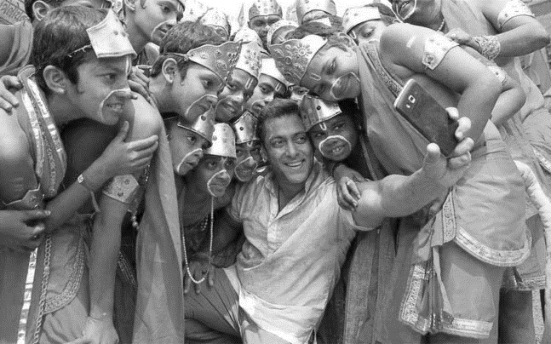
Your Investment Plan Selfie #IPSelfie
The algorithm is based on behavioral & need assessment questions
Measures your Risk Tolerance Level
The suggested fund most often not only protect your hard earned money but also delivers better post-tax returns.

Slide 16

your Investment Navigation
Get Started Now
Speak to our advisor on
011-30018181
or
Email us at Info@fincart.com

